Slide 1



Welcome

Slide 2

CLIMATE FORECAST
PROJECT ANALYSIS ON GLOBAL TEMPERATURE TRENDS
Presented by:
P. Swetha

Slide 3
INTRODUCTION
Comprehensive analysis of global temperature data.
Focus on seasonal temperature anomalies.
Utilization of statistical and machine learning techniques.

Slide 4

DATA PREPARATION
Libraries used: pandas, numpy, seaborn, matplotlib, sklearn, statsmodels.
Dataset: Loaded from global_temps.csv containing global temperature anomalies.

Slide 5
SEASONAL DATA MAPPING
Seasonal abbreviations mapped to full names:
DJF (Winter)
MAM (Spring)
JJA (Summer)
SON (Fall)

Slide 6
EDA & OUTLIERS
•Visualization: Line plot showing seasonal temperature changes.
Dark background for contrast.
Markers for clarity.
Outliers identified in DJF data using the Interquartile Range (IQR) method.
Calculation of Q1 and Q3 to determine outlier thresholds.

Slide 7
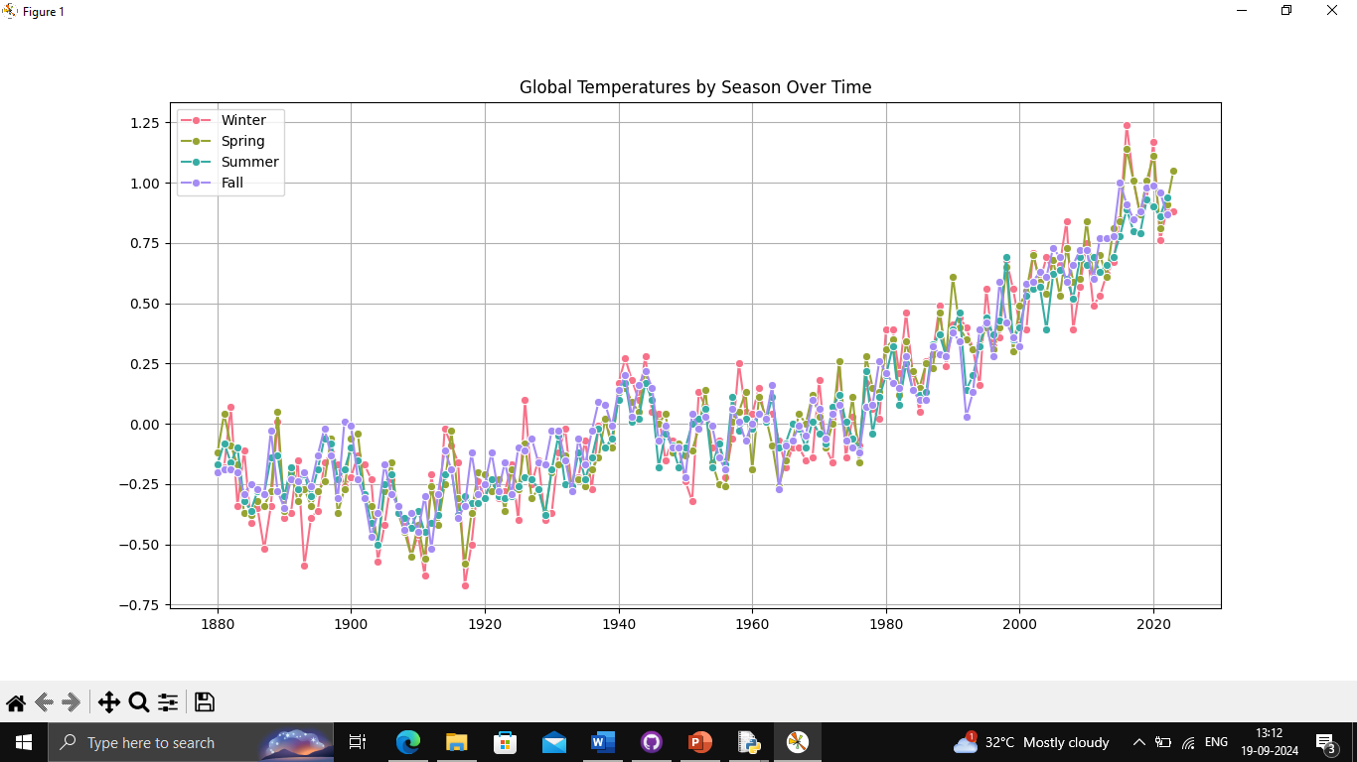
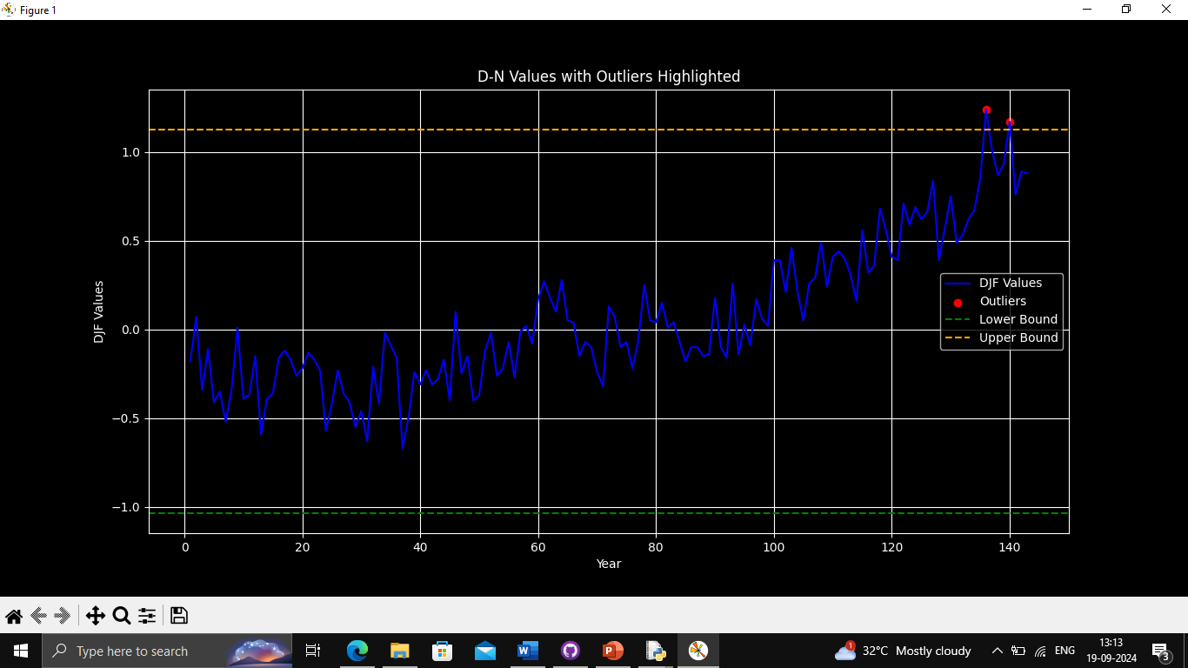
OS

Slide 8
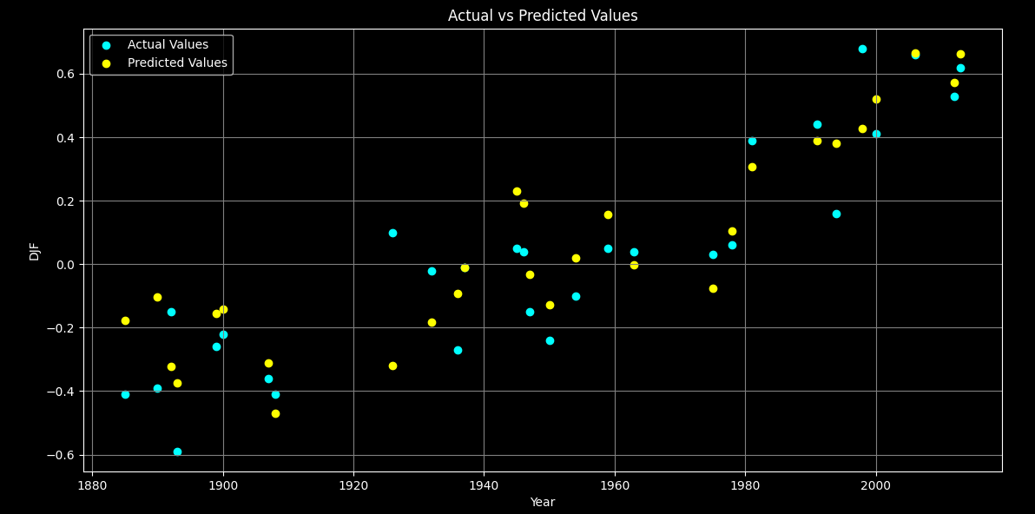
ML MODELS
Random Forest Regression: Predicts DJF temperature anomalies.
Evaluated using Mean Squared Error (MSE) and R² score.
Scatter plot comparing actual vs. predicted values.

Slide 9
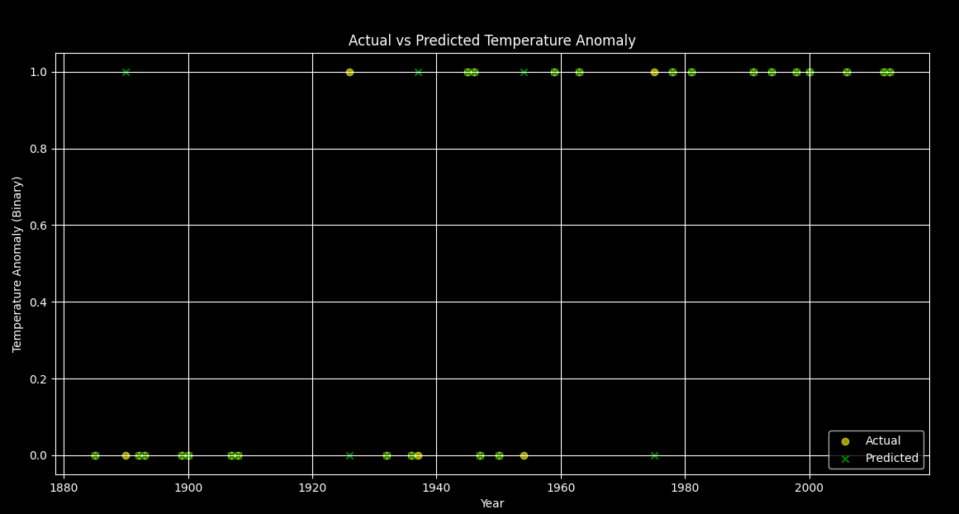
Random Forest Classifiers : Classifies DJF temperatures as above or below zero.
Evaluation includes confusion matrix and classification report.

Slide 10
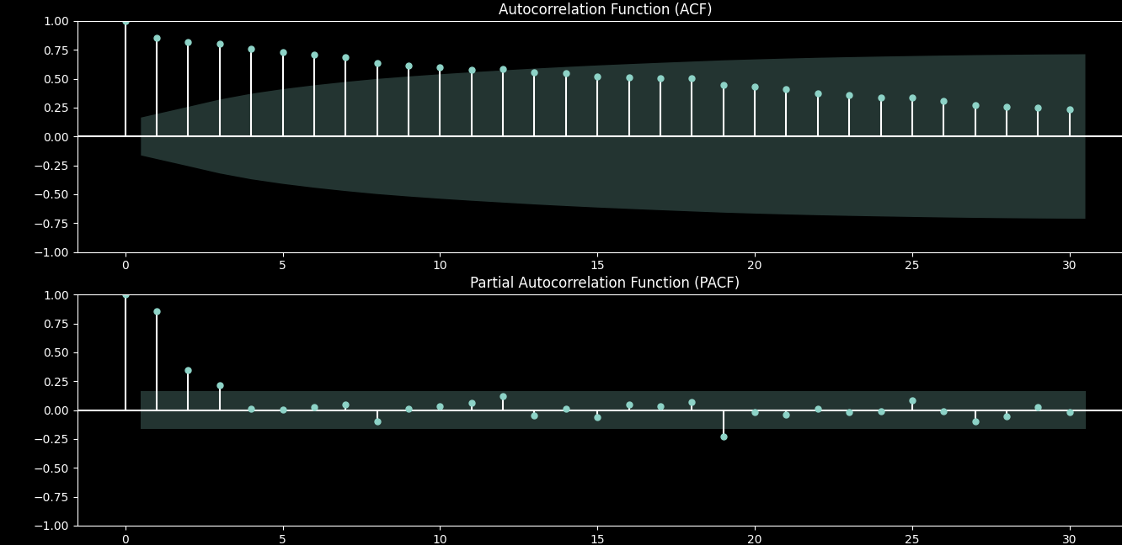
TIME SERIES ANALYSIS
ARIMA model implementation for time series forecasting.
Stationarity checked with Augmented Dickey-Fuller test.
ACF and PACF plots used to determine ARIMA parameters.

Slide 11
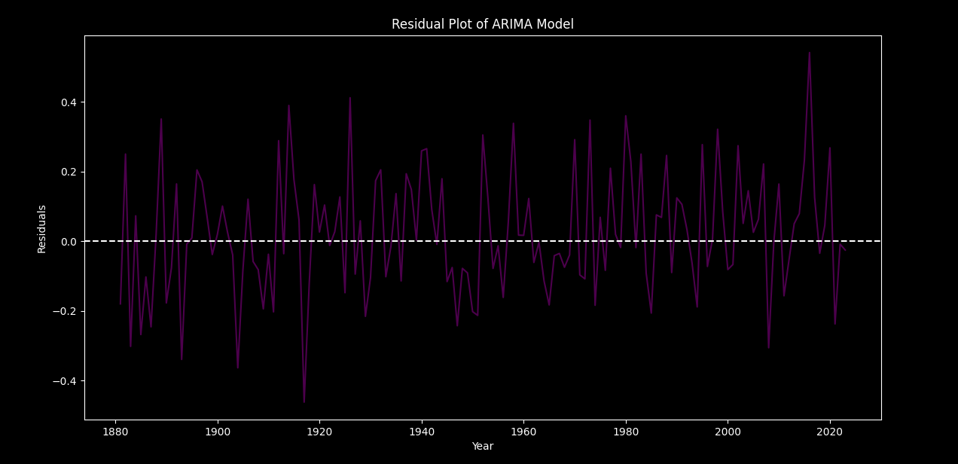
FORECASTING WITH ARIMA
ARIMA model fitted to DJF data with generated forecasts.
Analysis of residuals to assess model accuracy.

Slide 12
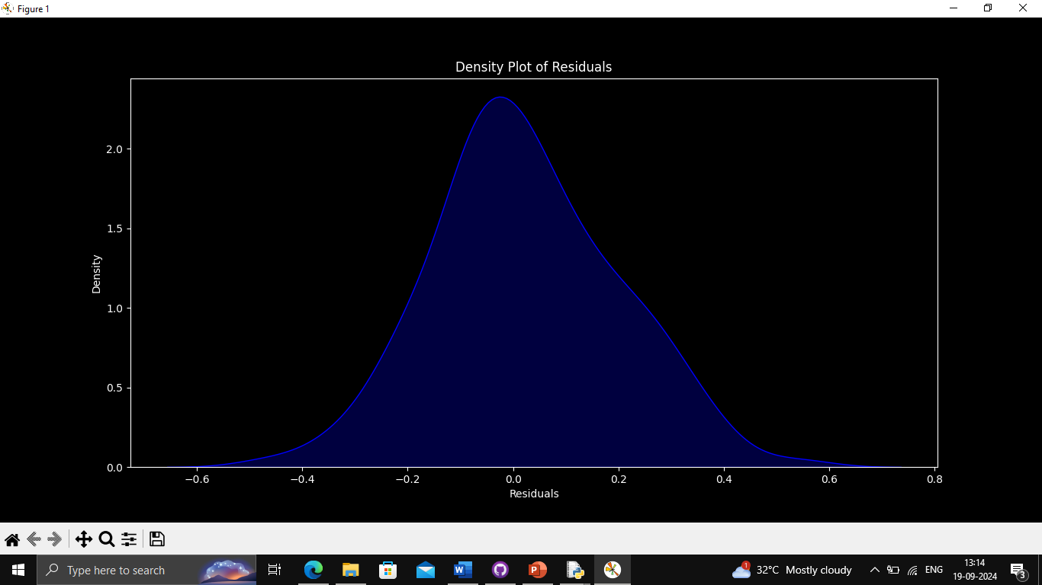
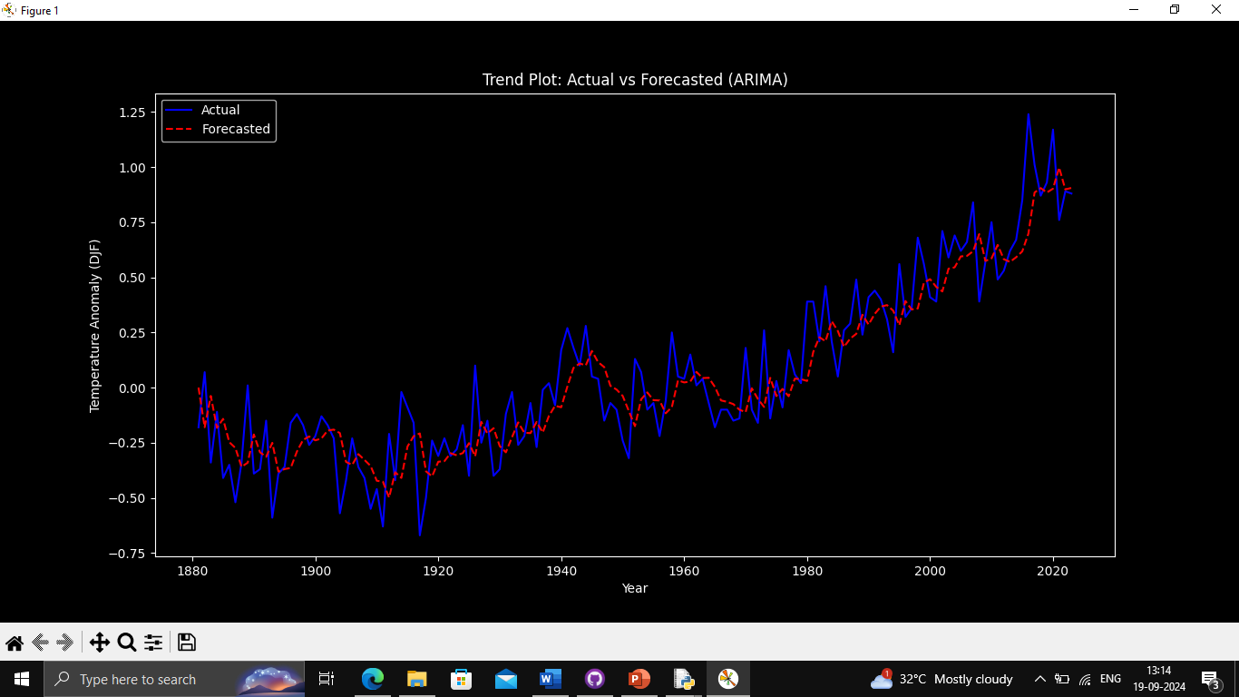

Slide 13
Administrators can leverage the dashboard to oversee the overall operations of the real estate agency, track sales metrics, and generate reports for analysis and decision-making
Thank You

